Slide 1
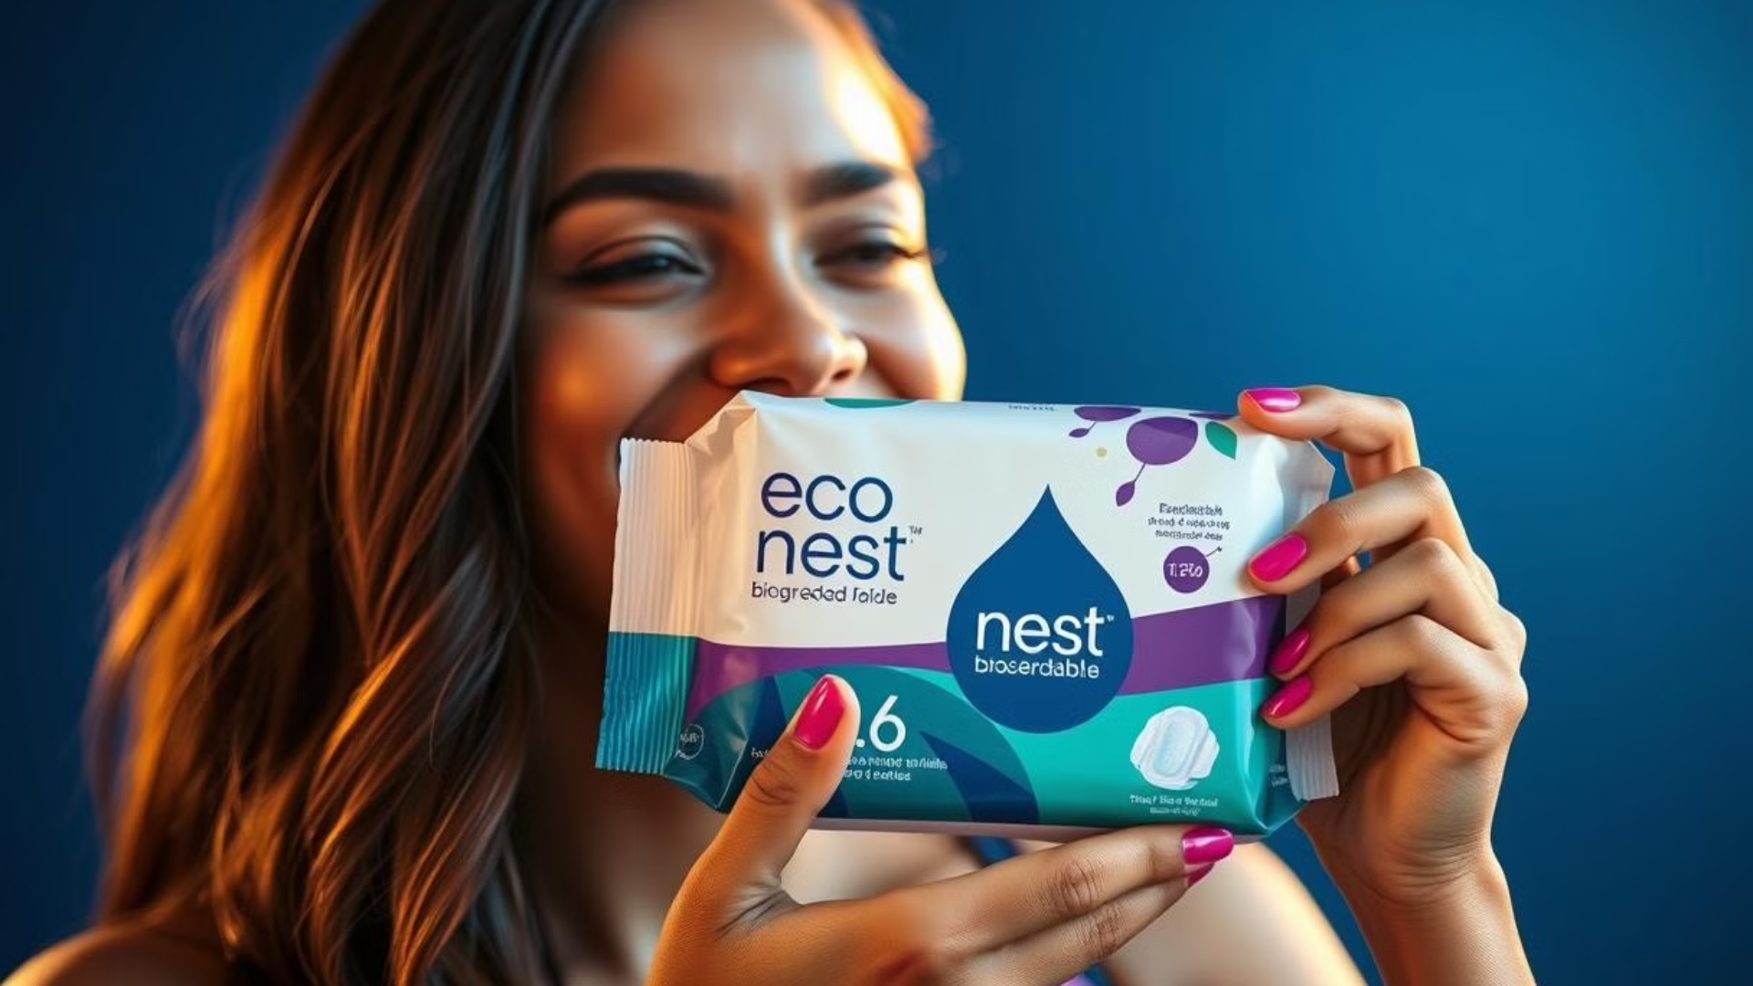
Echra Innovations
Where innovation meets sustainability
Discover91 DEGREES, a revolutionary brand of biodegradable sanitary pads from the house of ECHRA ,designed for comfort, confidence, and a cleaner planet. Join us on a journey toward sustainable feminine hygiene.

Slide 2
Introducing 91 degrees: The Future of Feminine Hygiene
Eco-conscious choice
Designed for you
Eco Nest is a new generation of sanitary pads made with biodegradable materials, reducing waste and environmental impact.
Enjoy superior comfort and confidence with our breathable, hypoallergenic design, crafted for a smooth and natural feel.

Slide 3
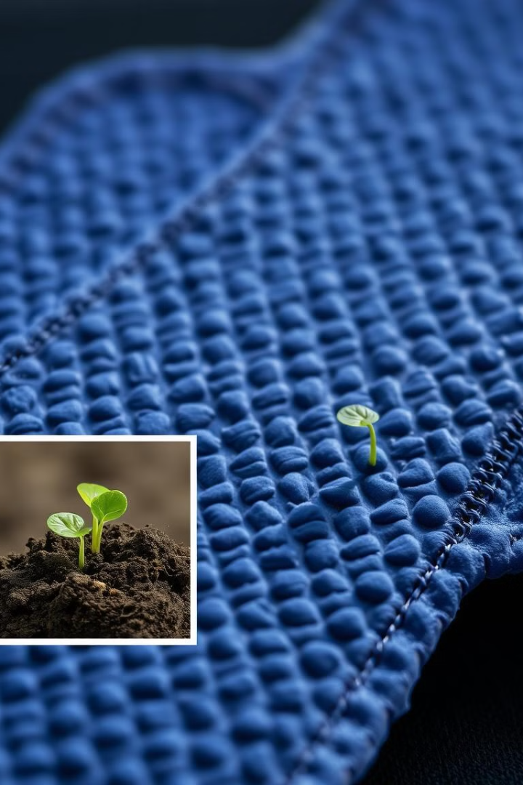
Innovative, Biodegradable Design
1
Natural Materials
2
Biodegradable Breakdown
Made with plant-based materials like bamboo and cornstarch, Eco Nest pads are gentle on your skin and the environment.
Our pads decompose naturally in landfills, leaving no harmful residues behind. They break down quickly and safely.
3
Effective Protection
Despite being biodegradable, Eco Nest pads provide the same level of protection and absorbency as traditional pads.

Slide 4



Reduced Environmental Impact
1
Minimized Waste
2
Reduced Landfills
3
Preserved Ecosystems

Slide 5



Improved Feminine Hygiene
Comfort
Health
Confidence
The breathable and hypoallergenic design of Eco Nest pads allows your skin to breathe, reducing discomfort and irritation.
Made with natural materials, Eco Nest pads are gentle on your skin and free from harsh chemicals, promoting a healthy intimate environment.
Experience the freedom and peace of mind that comes with using a product designed to be both effective and eco-friendly.

Slide 6
Comfort and Confidence
Natural Feel
1
Eco Nest pads provide a gentle and natural feel, reducing irritation and discomfort.
Breathable Design
2
Our breathable design allows air to circulate, keeping you feeling fresh and comfortable all day long.
Leakproof Protection
3
Experience the security of knowing you're protected with our leakproof design.

Slide 7

Social Impact: Supporting Women
Empowering Women
We are committed to creating opportunities for women in our supply chain, supporting their economic empowerment.
Sustainable Practices
By choosing Eco Nest, you're contributing to a more sustainable and equitable future for all women.
1
2
3
Community Engagement
We actively engage with communities to educate about sustainable feminine hygiene practices and support women's health.

Slide 8
Why Choose 91 degrees?
Eco-Friendly
Superior Comfort
Reduce your environmental impact with biodegradable sanitary pads that are gentle on the earth.
Enjoy the comfort and confidence that comes with our breathable and hypoallergenic design.
Reliable Protection
Social Responsibility
91 degrees provides the same level of protection and absorbency as traditional pads, while being better for the planet.
Support women's empowerment and a more sustainable future with 91 degrees.

Slide 9
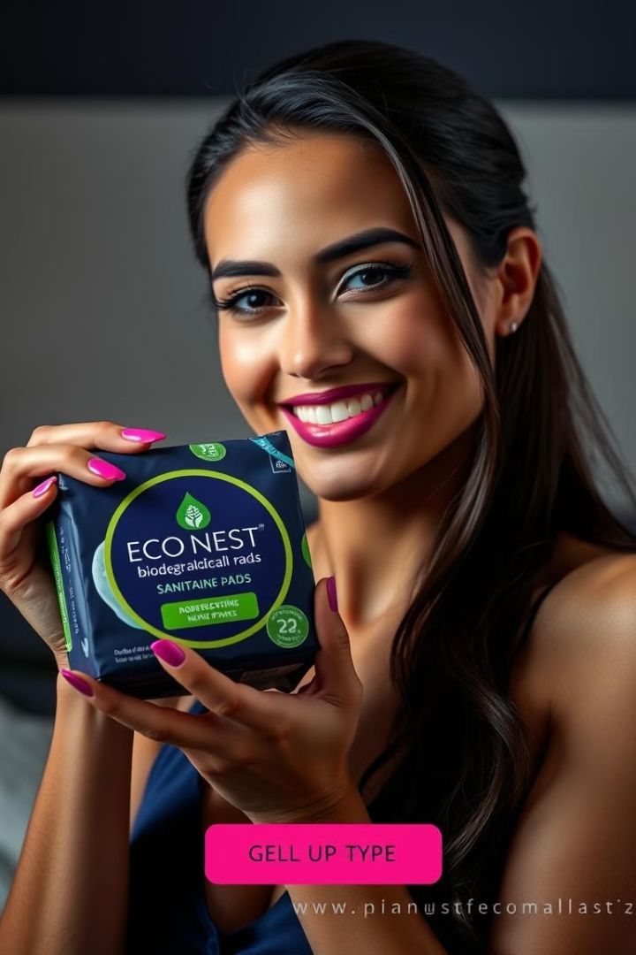

Get Your pad Today

